Slide 1


IoT in Agriculture
Harishankhar T K
CB.EN.U4ECE20221
Crop - Paddy
Shailesh.R
CB.EN.U4ECE20254

Slide 2
Problem Statement
Given a set of images of paddy that has diseases, namely bacterial leaf blight, brown spot and smut, the IoT device will perform the following :
1. To compile a dataset of images corresponding to different diseases that affect paddy most commonly
2. Improve the accuracy of diseases

Slide 3
About the dataset
Dataset consists of 123 images with:
40 images – Bacterial leaf blight
40 images – Brown spot
40 images – Leaf smut
3 images – non – diseased crops
Source : Kaggle,TNAU

Slide 4
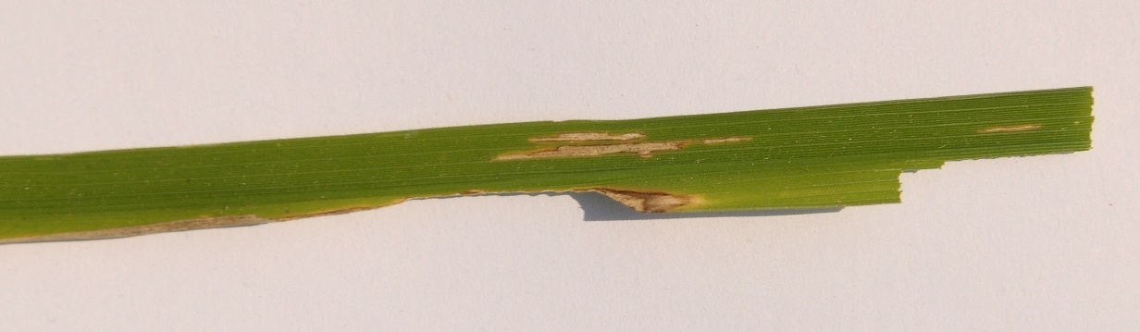
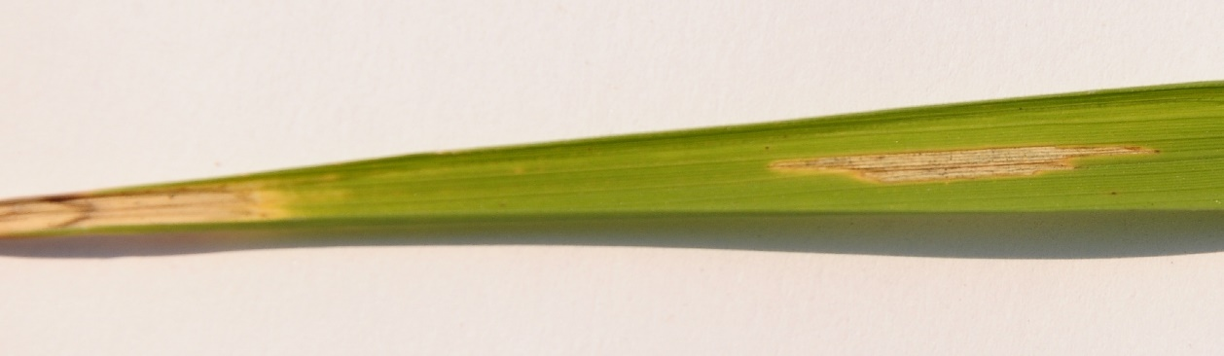
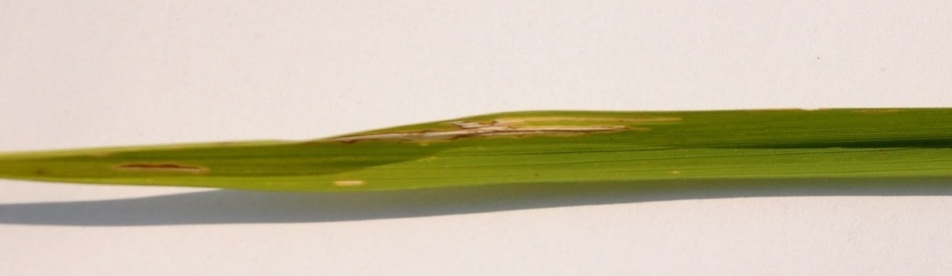
Bacterial leaf blight – sample images
In severe epidemics, crop loss may be as high as 75 percent, and millions of hectares of rice are infected annually.
Water-soaked to yellowish stripes on leaf blades or starting at leaf tips then later increase in length and width with a wavy margin
Appearance of bacterial ooze that looks like a milky or opaque dewdrop on young lesions early in the morning

Slide 5
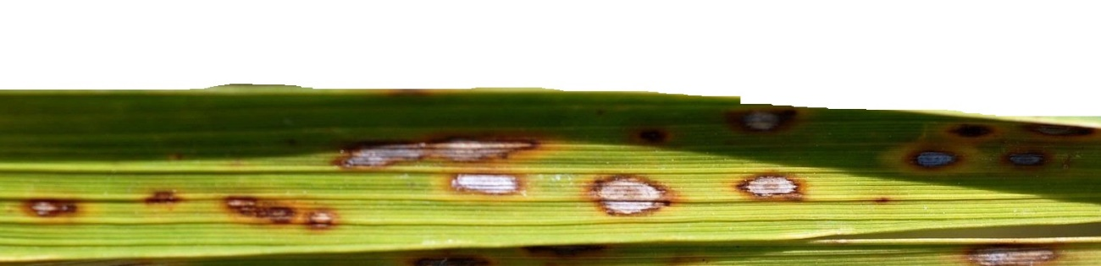
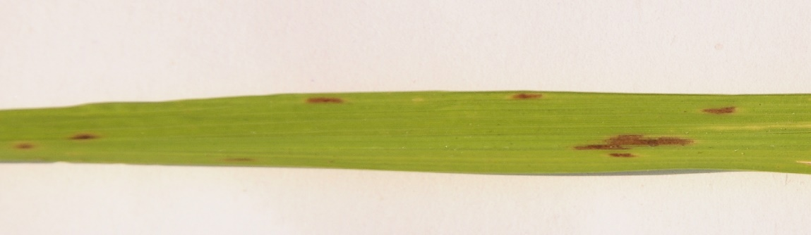
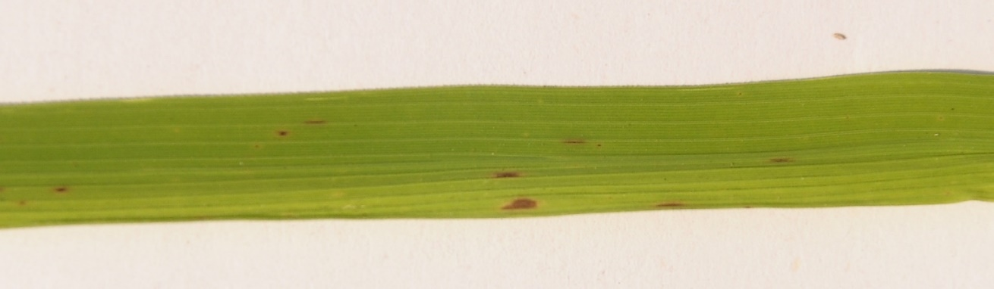
Brown spot – sample images
Its most observable damage is the numerous big spots on the leaves which can kill the whole leaf. When infection occurs in the seed, unfilled grains or spotted or discolored seeds are formed.
On average, the disease causes 5% yield loss across all lowland rice production in South and Southeast Asia. Severely infected field can have as high as 45% yield loss.

Slide 6
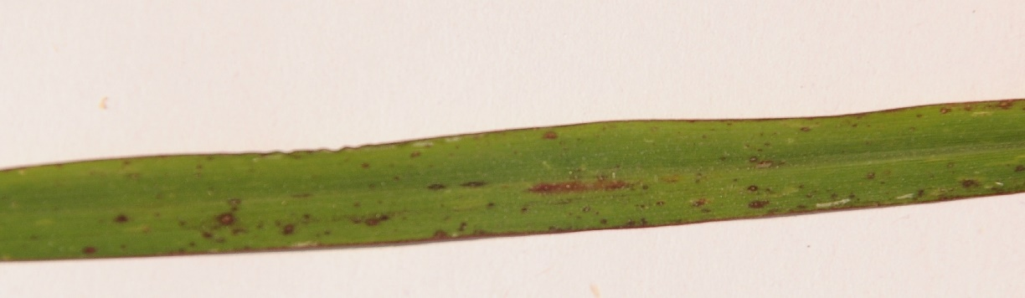
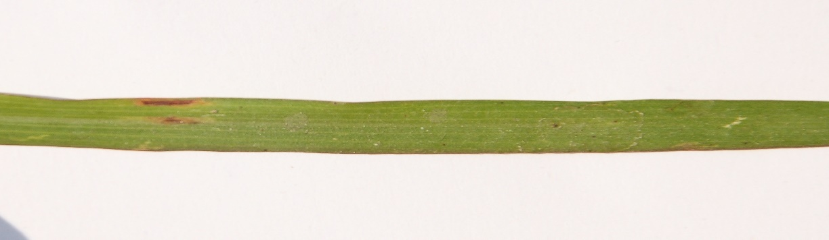
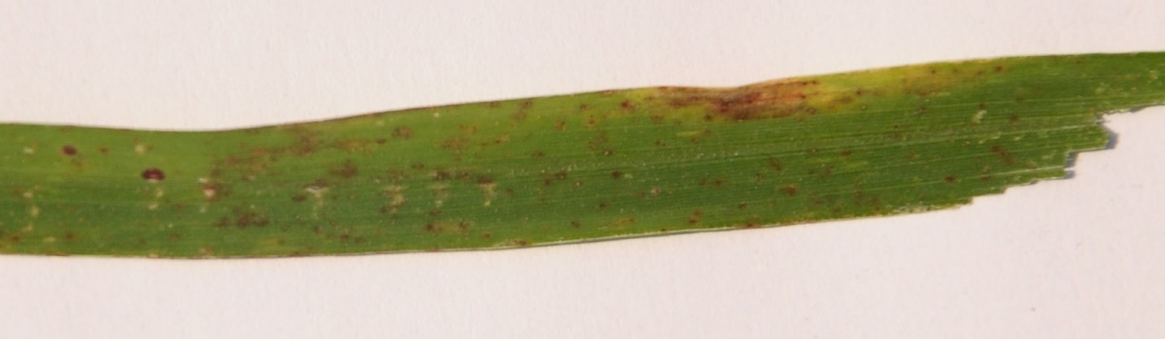
Leaf smut – sample images
The fungus produces slightly raised, angular, black spots (sori) on both sides of the leaves

Slide 7
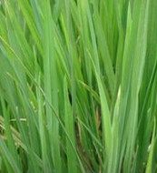
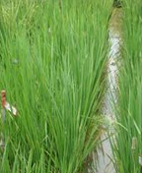
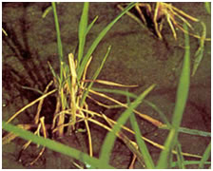
Healthy leaves – sample images

Slide 8
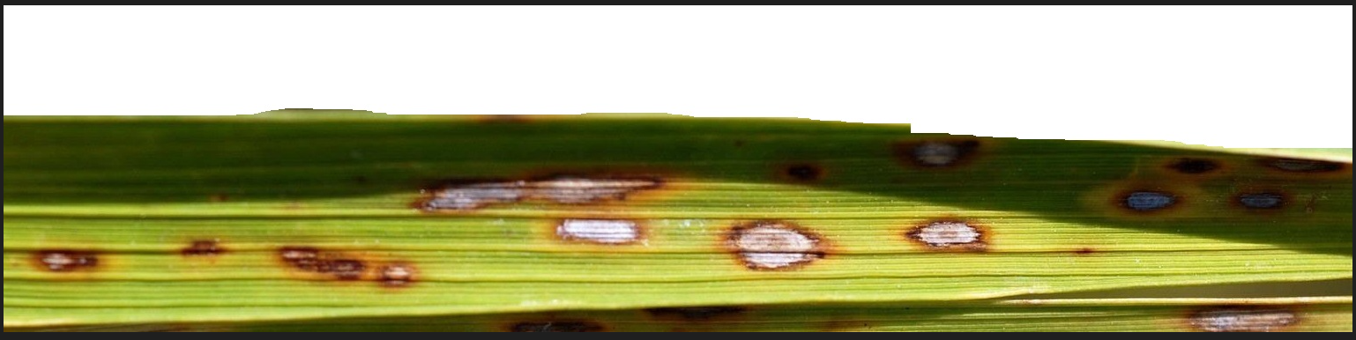
Sample image used FOR IMAGE PROCESSING CODE SNIPPETS

Slide 9
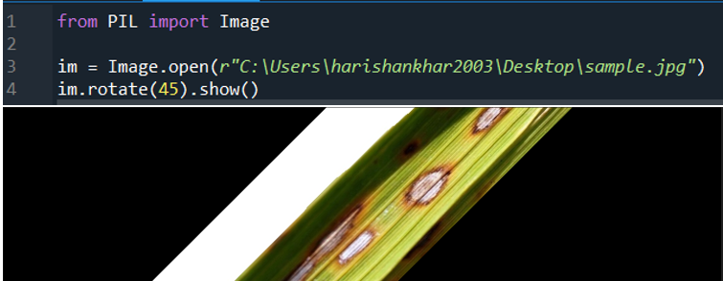
1

Slide 10
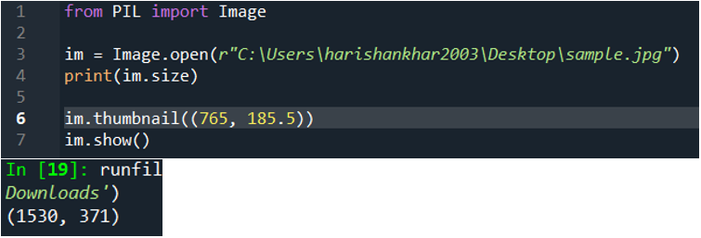
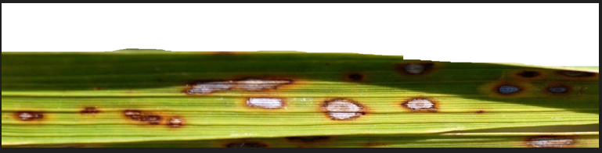
2

Slide 11
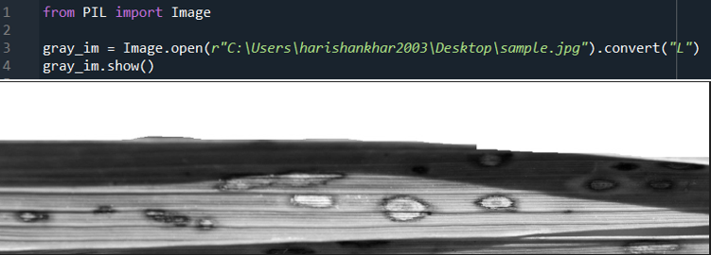
3

Slide 12
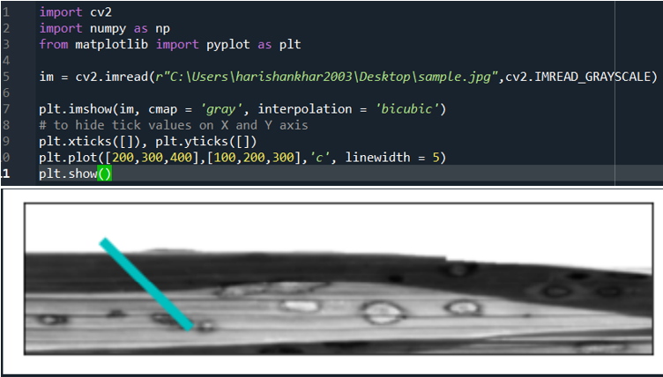
4

Slide 13
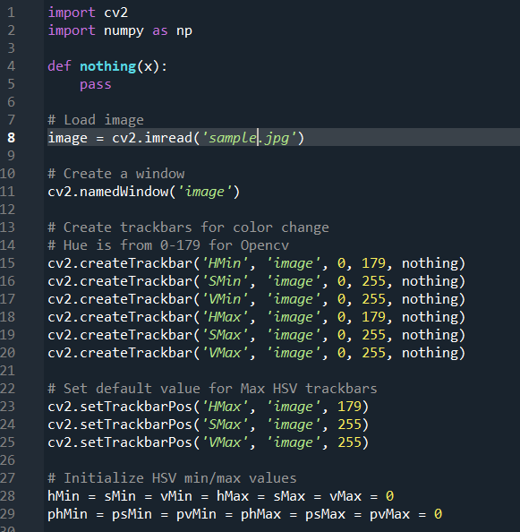
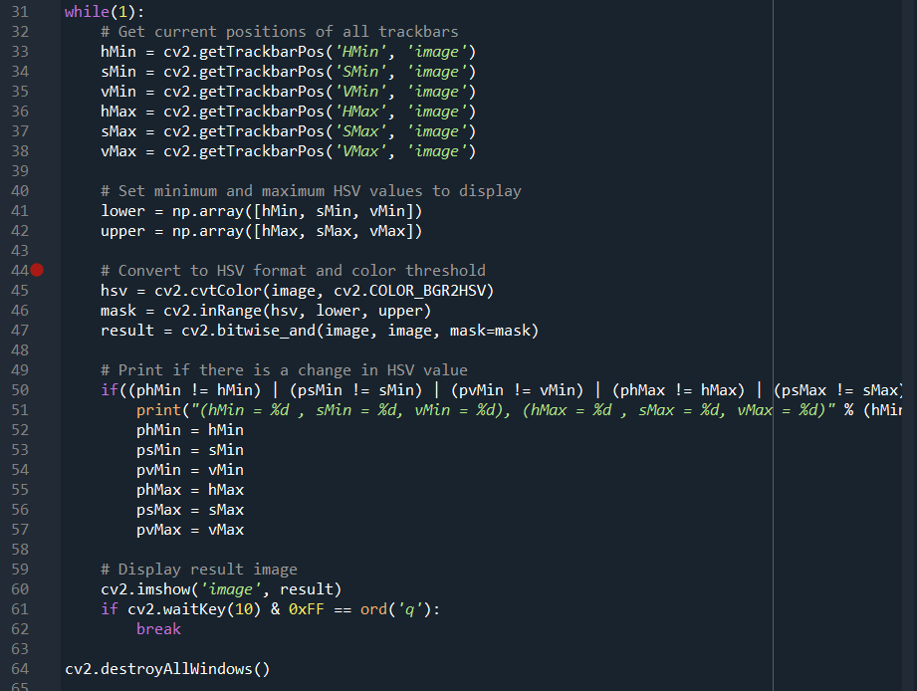
5

Slide 14
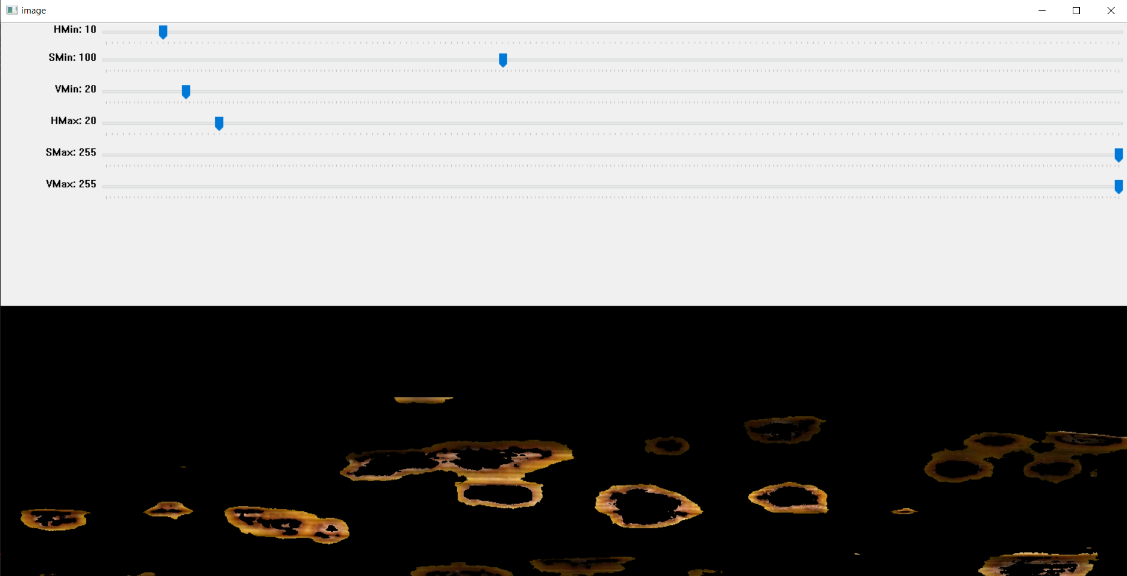

Slide 15
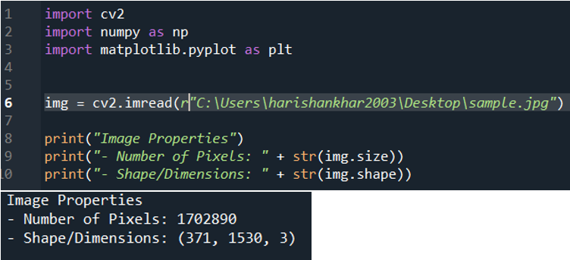
6

Slide 16
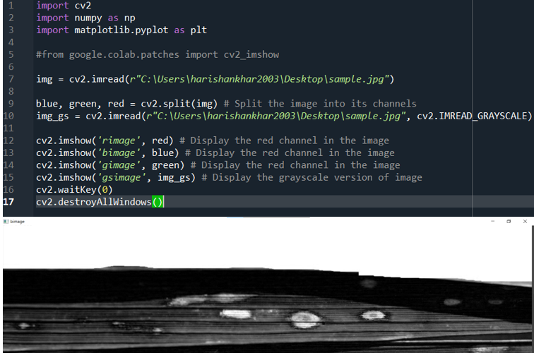
7

Slide 17
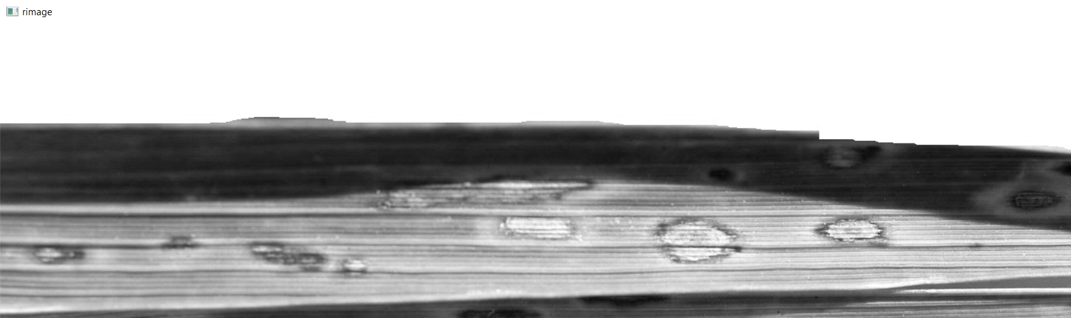
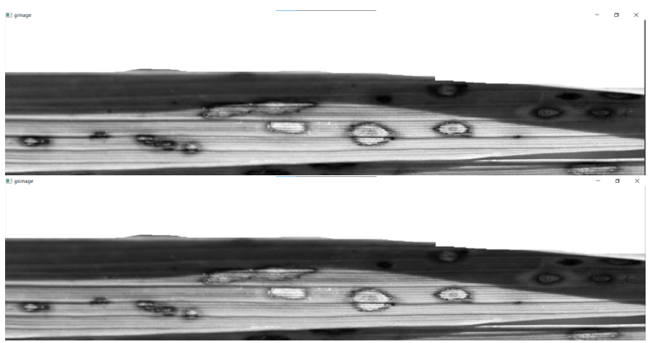

Slide 18
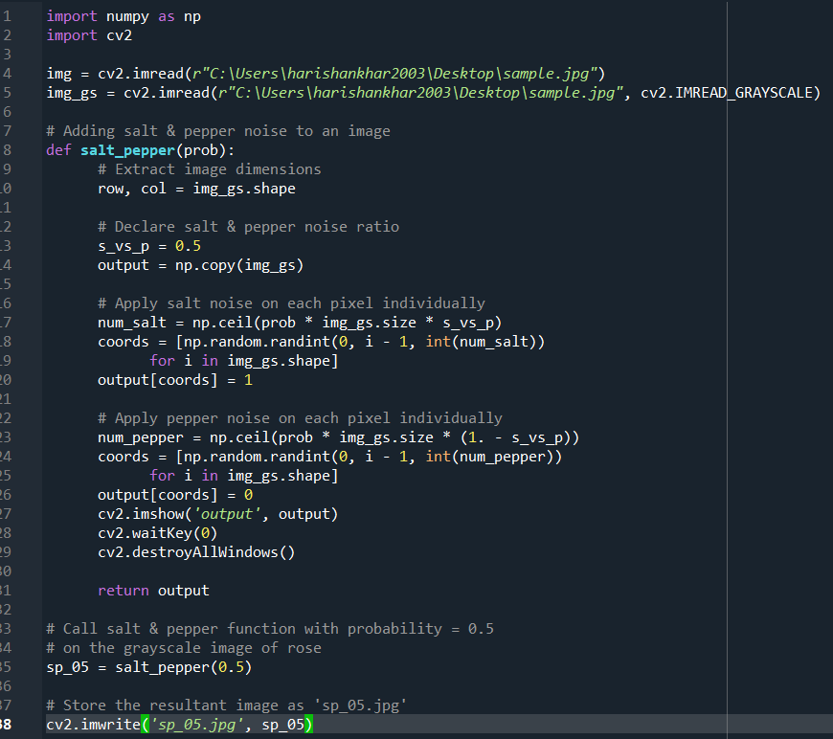
8

Slide 19
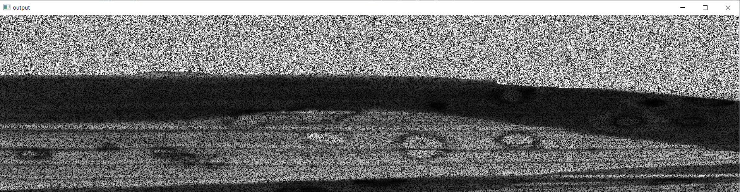

Slide 20
Sensors
DHT11/DHT22 (Temperature Humidity sensor)
DS18B20 (Temperature Sensory)
BMP180 Barometer (Pressure sensor)
Moisture sensor
Raindrop sensor
HC-SR501 Pyroelectric Infrared PIR motion sensor

Slide 21
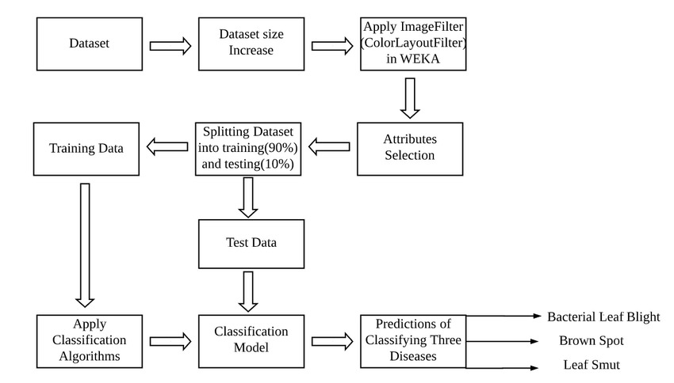
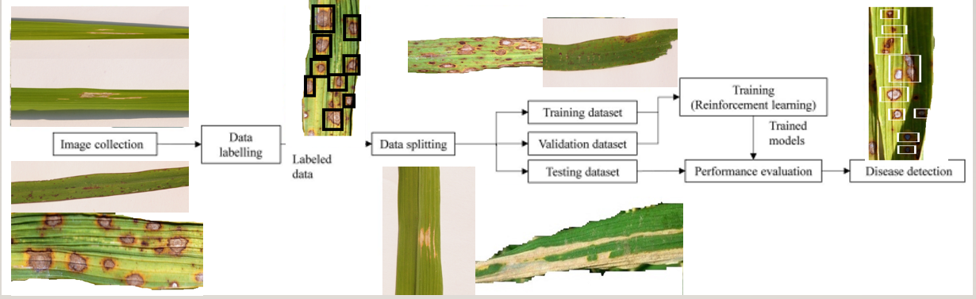
PROPOSED WORKFLOW(IN TERMS OF DISEASE DETECTION):

